Slide 1



Welcome to Online Class for HCI

Slide 2
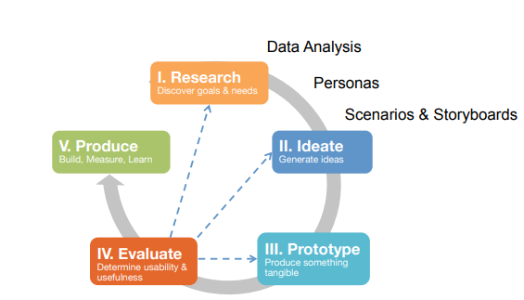
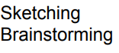

Slide 3
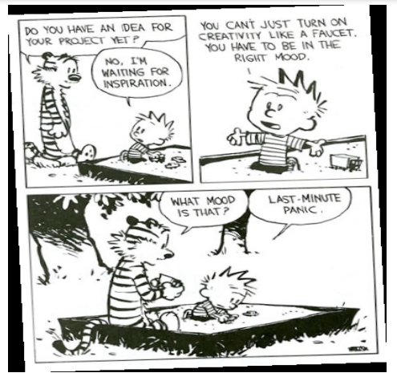
Ideation
A Generate ideas to find solutions for the problem space

Slide 4
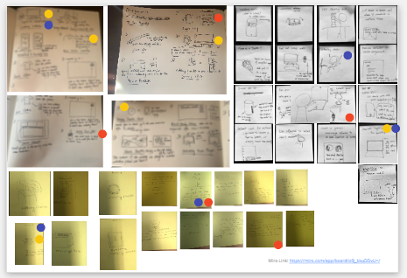
Ideation
Example
Ideate to change sedentary behaviors of an individuals

Slide 5
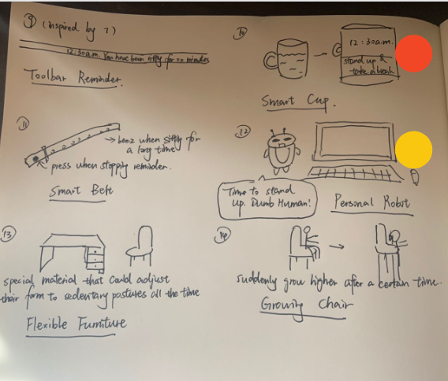
Ideation
Example
Ideate to change sedentary behaviors of an individuals

Slide 6
Ideation
Tips
Sketching is useful for idea generation
If you're stuck on coming up with ideas, there are lots of things you can do to inspire creativity
Sketch ideas in a group to build off each others’ ideas, but defer judgment until you start the filtering

Slide 7

Inspire Creativity
Think like a children
Children are creative because they don't know the rules, and thus break them all the time
Children don't know the consequences, and thus are more likely to take risks

Slide 8
Inspire Creativity
Think of current trends: Distributed, social, community-driven,
sensors, networks, ambient, invisible, mobile,
reconfigurable, fashion, adaptive
Combine the design in an ensemble
Look to current trends and explore future possibilities, think of sci-fi
Read science fiction
Take things from one domain and try them in another
Magnify-add to the design
Think like a children
Modify the design for a new purpose
Leave your comfort zone
Adapt the design to be something else
New uses of the design
Minimize-subtract from the design
Substitute within the design

Slide 9
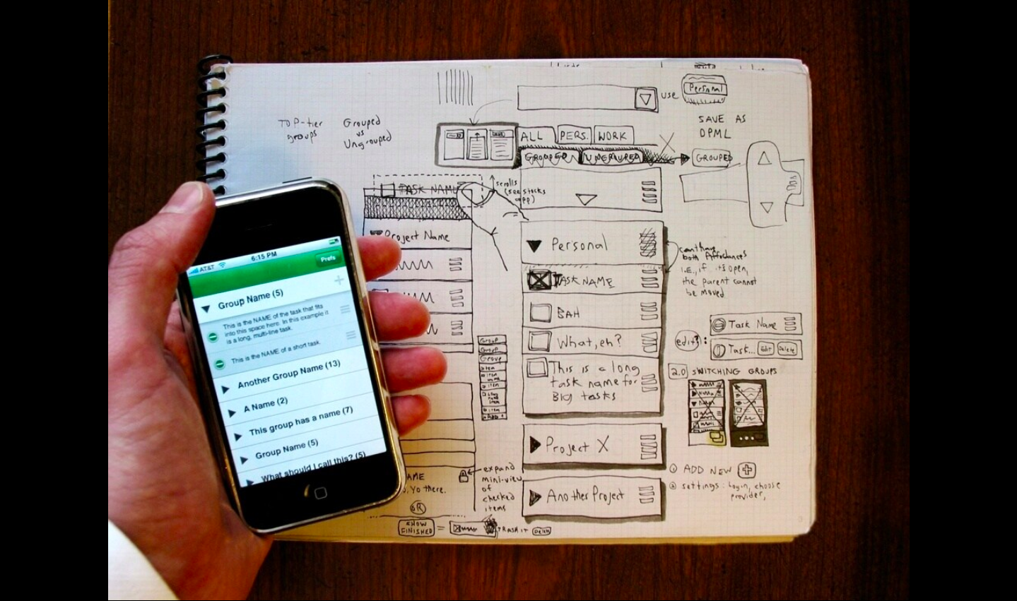
Sketching
Fahey , C. (2008). Talking About Sketching About Interacting. https://www.slideshare.net/askrom/talking-about-sketching-about-interacting-presentation
Notes:
Buxton, B. (2007). Sketching user experiences: getting the design right and the right design. Morgan Kaufmann.
Sketching is a very efficient way of communicating design while allowing designers to try out a multitude of ideas and iterate them before settling on one.
The main purpose of sketches is to help you think more clearly, find better solutions, and save time.

Slide 10
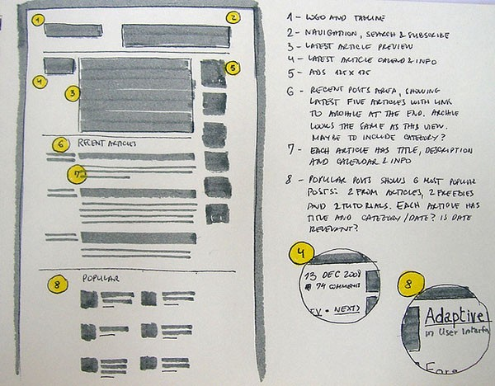
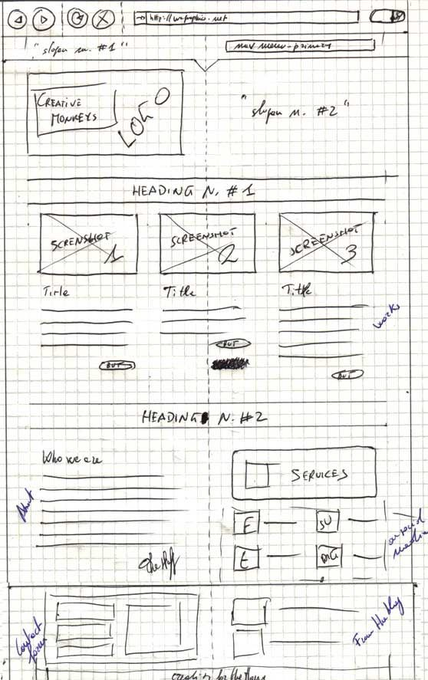
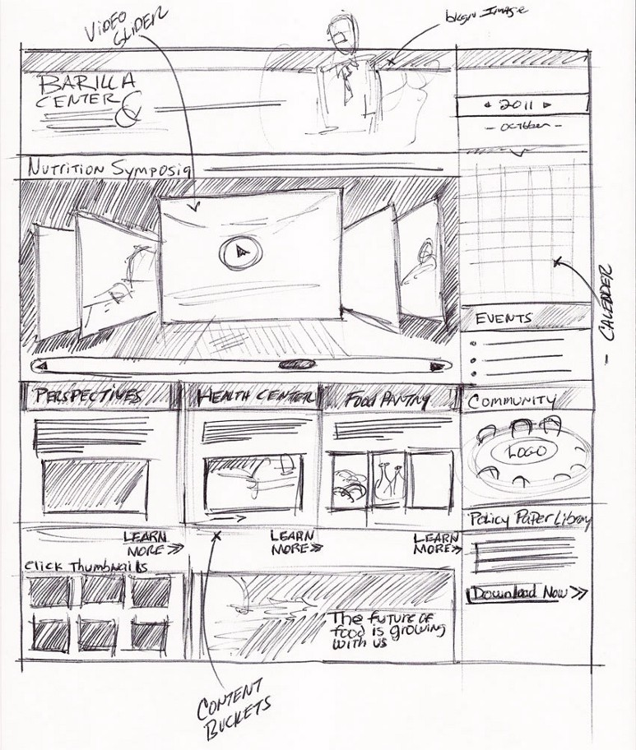
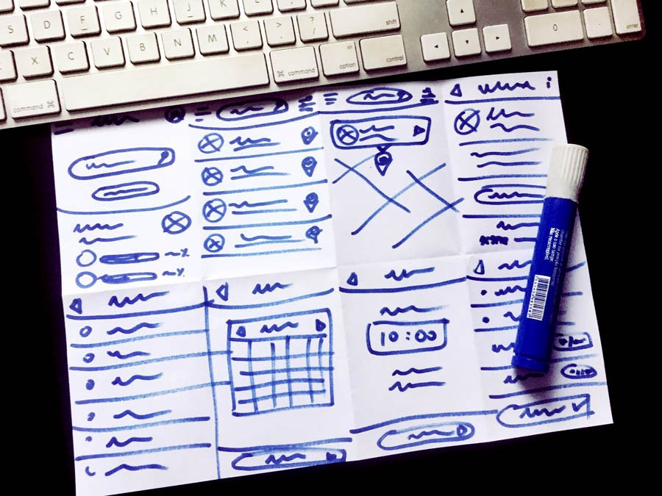
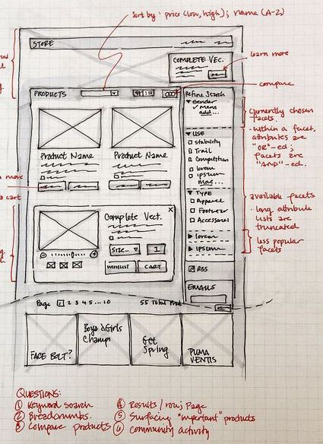
A selection of sketches
https://uxplanet.org/getting-started-with-wireframing-8bf5eedd2d30
Notes:
Prompt students about differences and similarities of the sketches

Slide 11
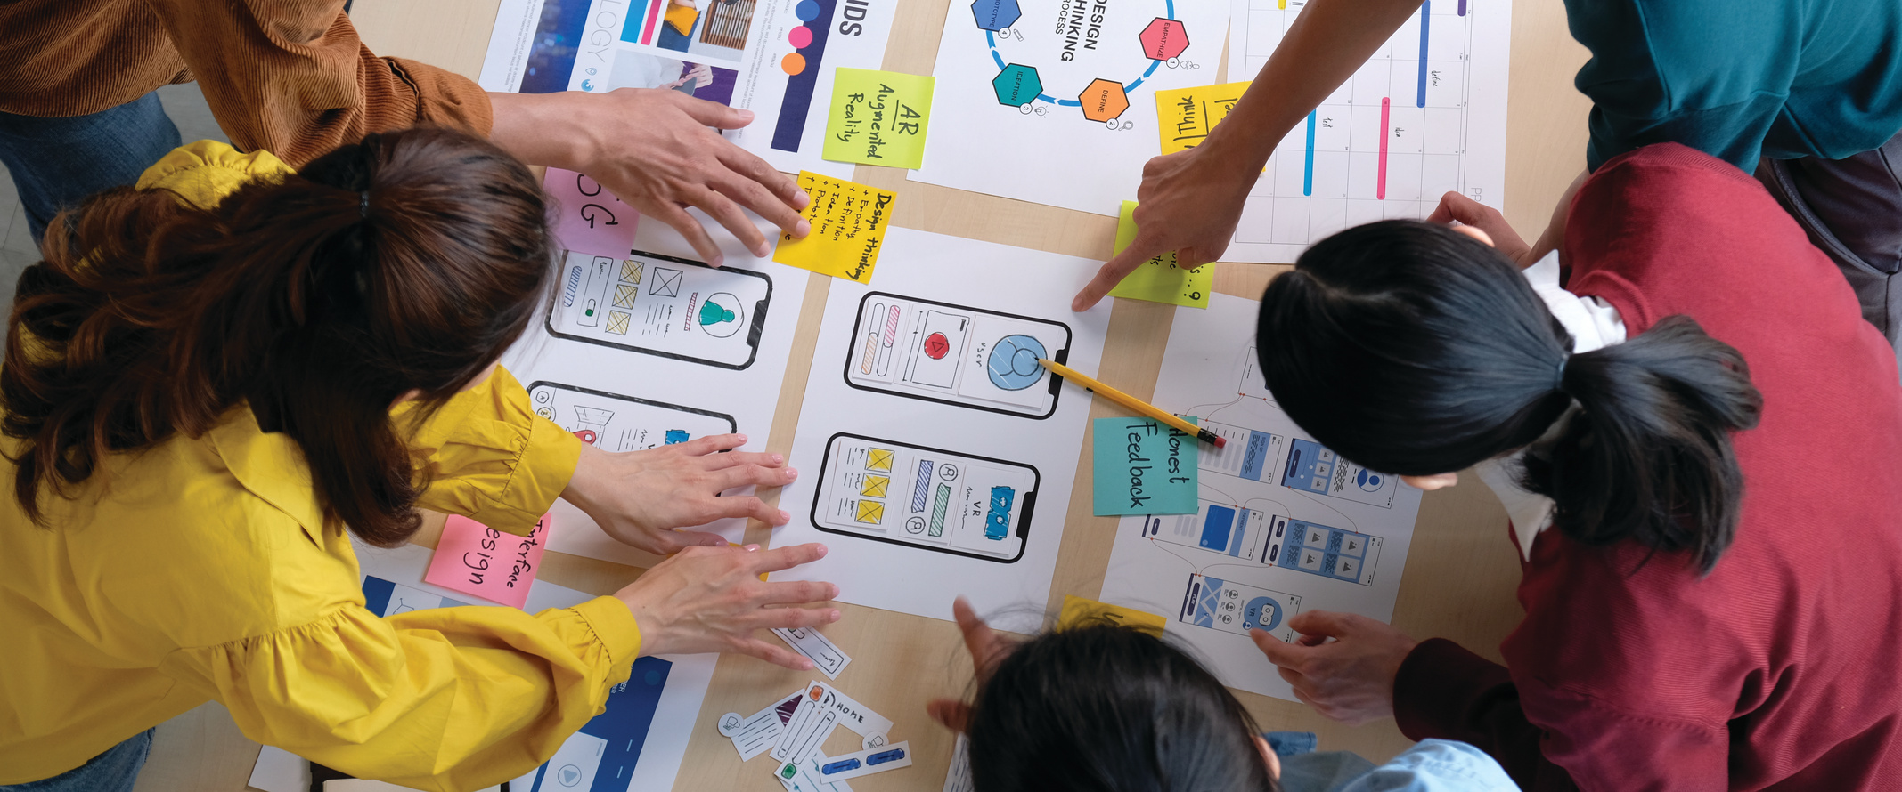


Qualities of hand-drawn sketches?
Notes:
It’s quick, easy, and everyone can see what you mean.
Even when working alone, sketching multiple quick ideas helps combine and consolidate your thoughts as you go, meaning you’ll still be able to easily communicate the how, why, and most importantly who your designs will help.
It’s visual, if you’re quick to sketch, it helps overcome language barriers when working with international clients/customers.

Slide 12
Some Qualities of hand-drawn sketches…
Quick: A sketch is quick to make.
Timely: A sketch can be provided when needed.
Inexpensive: A sketch is cheap.
Disposable: If you can’t afford to throw it away when done, it is probably not a sketch.
Minimal detail: Include only what is required to render the intended purpose or concept. Superfluous detail is almost always distracting.
Buxton, B. (2007). Sketching user experiences: getting the design right and the right design. Morgan Kaufmann.
Notes:
It’s quick, easy, and everyone can see what you mean.
Even when working alone, sketching multiple quick ideas helps combine and consolidate your thoughts as you go, meaning you’ll still be able to easily communicate the how, why, and most importantly who your designs will help.
It’s visual, if you’re quick to sketch, it helps overcome language barriers when working with international clients/customers.

Slide 13
Hand-drawn sketches are…
Quick: A sketch is quick to make.
Timely: A sketch can be provided when needed.
Inexpensive: A sketch is cheap.
Disposable: If you can’t afford to throw it away when done, it is probably not a sketch.
Minimal detail: Include only what is required to render the intended purpose or concept. Superfluous detail is almost always distracting.
Ambiguous: Sketches are intentionally ambiguous, and much of their value derives from their being able to be interpreted in different ways.
Suggestive and explore rather than confirm: Their value lies not in the artifact of the sketch itself, but in its ability to provide a catalyst to the desired and appropriate behaviors, conversations, and interactions.
Buxton, B. (2007). Sketching user experiences: getting the design right and the right design. Morgan Kaufmann.
Notes:
It’s quick, easy, and everyone can see what you mean.
Even when working alone, sketching multiple quick ideas helps combine and consolidate your thoughts as you go, meaning you’ll still be able to easily communicate the how, why, and most importantly who your designs will help.
It’s visual, if you’re quick to sketch, it helps overcome language barriers when working with international clients/customers.

Slide 14
A sketch has room for improvement and refinement
Notes:
... a sketch is incomplete, somewhat vague, a low-fidelity representation.
Too little fidelity and the argument is unclear.
Too much fidelity and the argument appears to be over—done; decided.
Learning from sketches is based largely on the ambiguous nature of their representation.
That is, they do not specify everything and lend themselves to, and encourage, various interpretations that were not consciously integrated into them by their creator.
https://unsplash.com/photos/HN1roKF-DS4

Slide 15
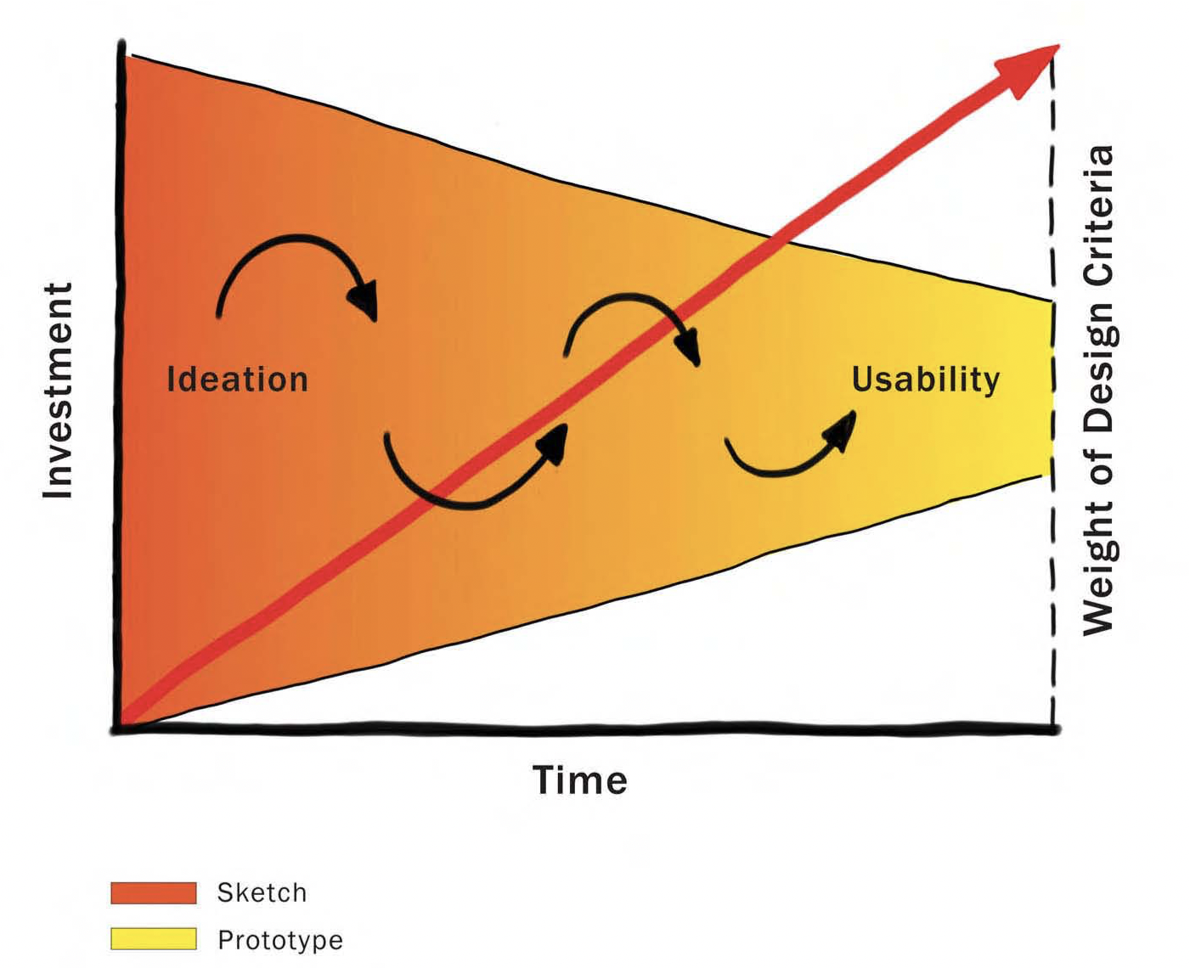
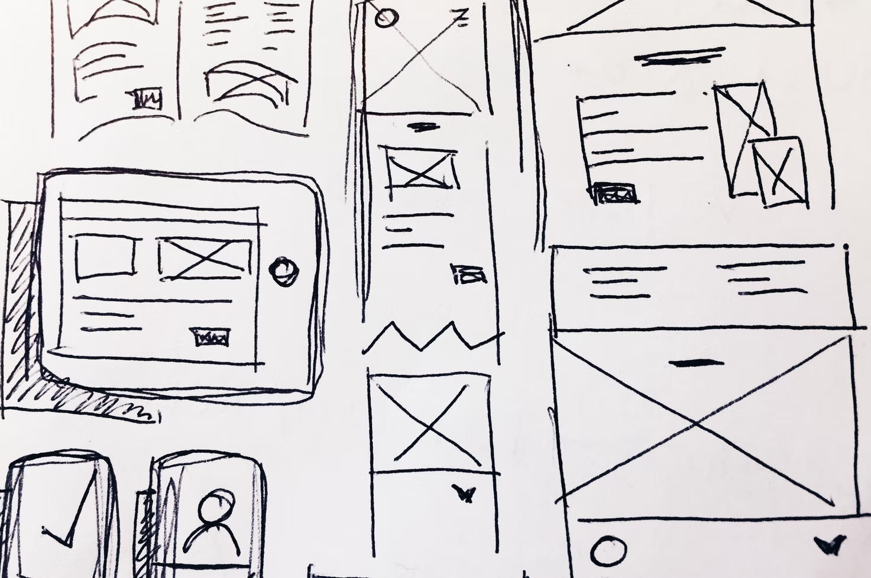
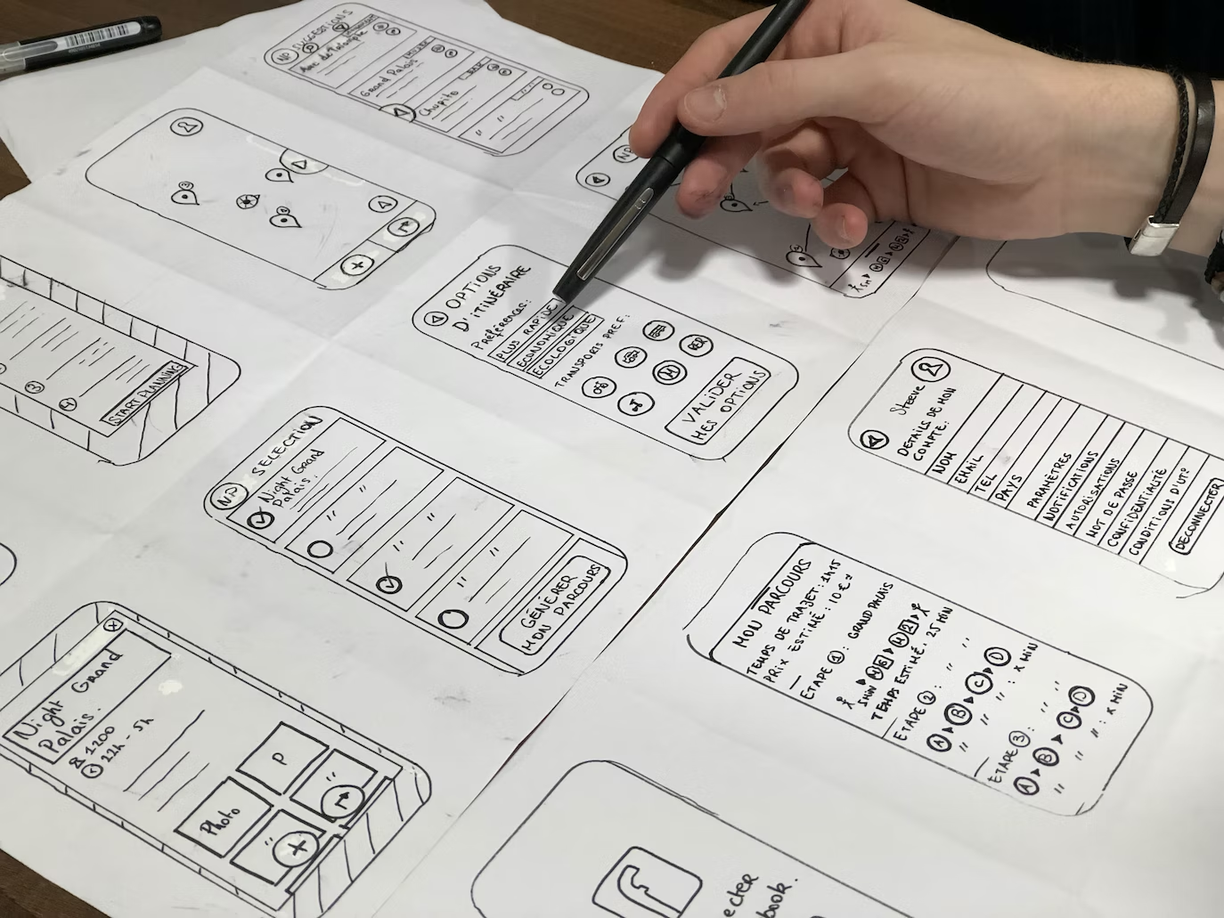
The Design Funnel
Buxton, B. (2007). Sketching user experiences: getting the design right and the right design. Morgan Kaufmann.
Notes:
The design funnel begins with ideation and ends with usability testing.
The former is largely dominated by sketching, which enables ideas to be explored quickly and cheaply.
More refined (and expensive) prototypes provide the basis for the testing at the later stages of design. Where testing is a key concern, the most dominant artifacts are more refined (and expensive) prototypes.
https://unsplash.com/photos/cj6Am4O7YJs
https://unsplash.com/photos/sv8oOQaUb-o

Slide 16

So what?!
Why would sketches be created from the very beginning of design, when just about everything is likely to change before you arrive at the final product?
Notes:
Sketching = Thinking
Designers do not draw sketches to externally represent ideas that are already consolidated in their minds. Rather, they draw sketches to try out ideas, usually vague and uncertain ones.
By examining the externalizations, designers can spot problems they may not have anticipated. More than that, they can see new features and relations among elements that they have drawn, ones not intended in the original sketch. These unintended discoveries promote new ideas and refine current ones.
One can get more out of a sketch than was put into making it because of its ambiguity. The fact that the sketch is, well, sketchy—that is, leaves a lot out, or leaves a lot to the imagination—is fundamental to the process.
https://unsplash.com/photos/h86ZkM5Qiqg

Slide 17
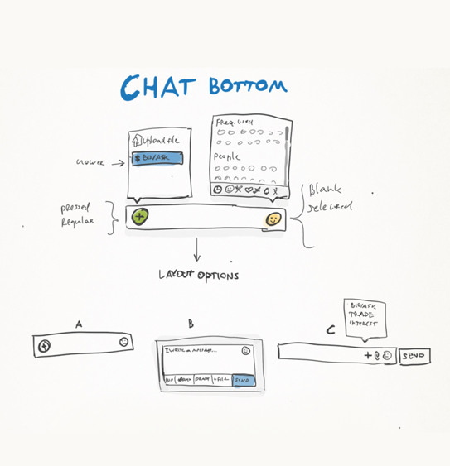

W3D1 | Class Activity:
Sketching [Individual Submission]
Put your phone on the desk and sketch your phone when it's off (1 sketch) and when it’s on (locked or home screen) (1 sketch). [10 mins]
Go to your either, your favorite app or your most often used app. Sketch 3 different interface screens/views/states of that app.
Include labels, arrows and explanatory text to describe your sketches and show a flow. [15 mins]
Pair up. Share and introduce your 3 sketches of your chosen app to your classmate. Provide useful feedback to each other on how to improve the sketches. Take notes of the feedback you receive. [15 mins]
Vyhouski, N. (n.p.). Everything You Need to Know About UX Sketching. https://www.toptal.com/designers/ux/guide-to-ux-sketching
Notes:
Get Paper and Pencil now
Go in breakout rooms (of 3 for small classes)
Feedback on critique
What did you like?
What did you not like?
If there would be one thing you could change, what would it be?

Slide 18




Question: To iterate an existing sketch or to make a new one
Should we just iterate, edit, amend an original sketch or create a series of evolutions of new sketches instead?
Notes:
annotate your designs

Slide 19
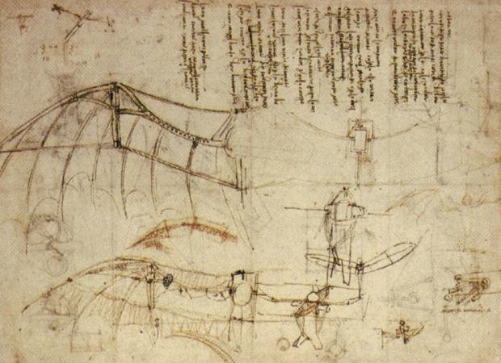
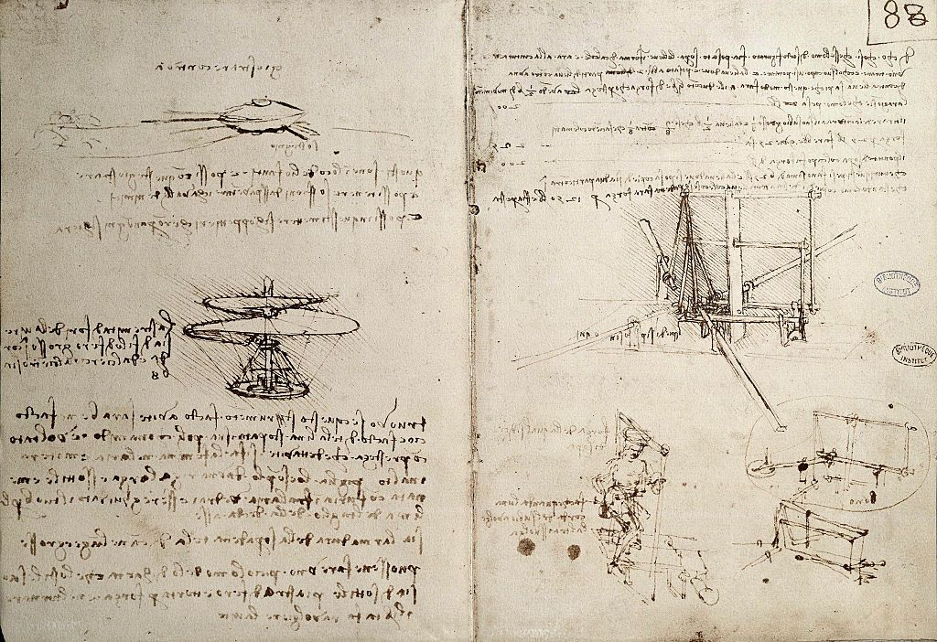
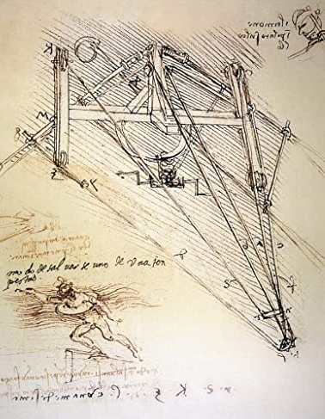
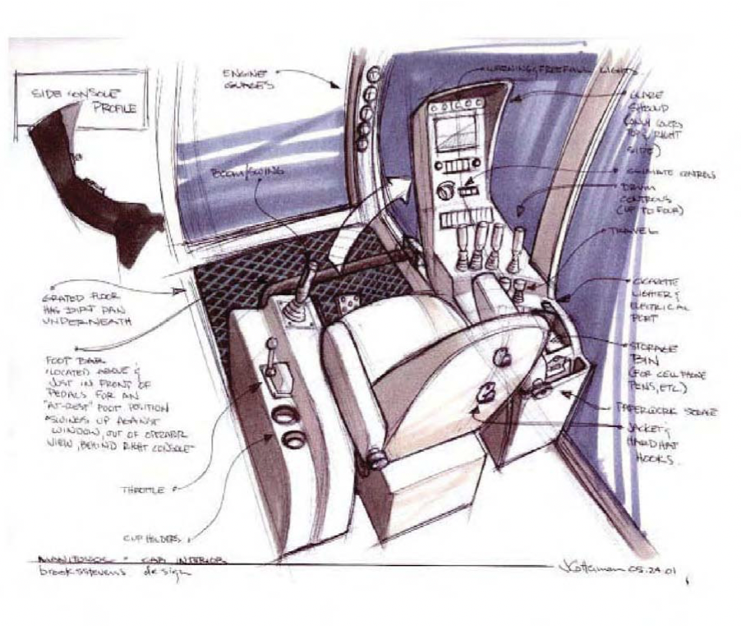
Sketches
… can be quite advanced, complex and sophisticated
Upper and left images:
Flying Machines from Leonardo Da Vinci
Bottom right image:
Cockpit Concept by Brooks Stevens Industrial Design
Notes:
https://commons.wikimedia.org/wiki/File:Leonardo_Design_for_a_Flying_Machine,_c._1488.jpg

Slide 20
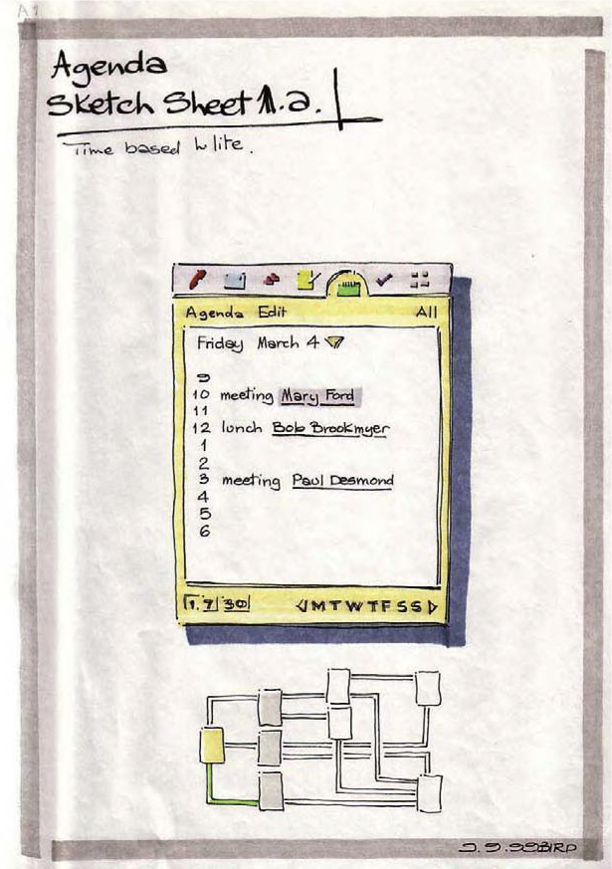
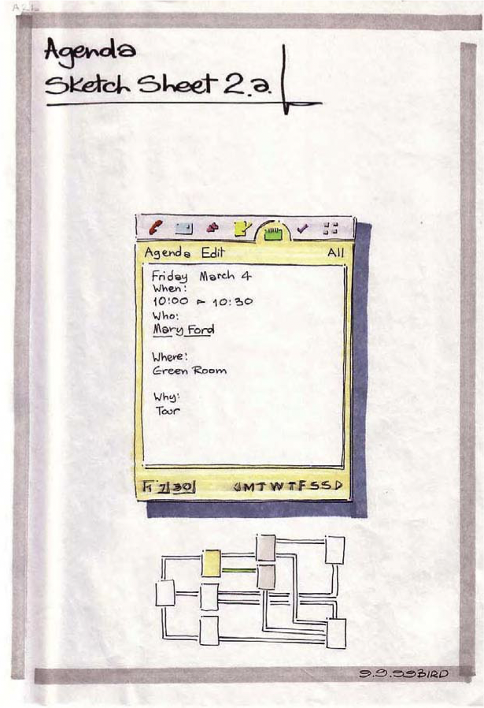
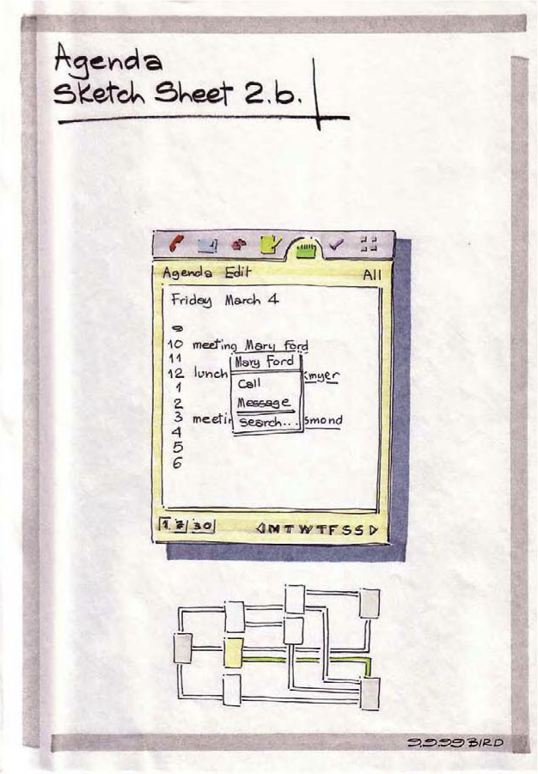
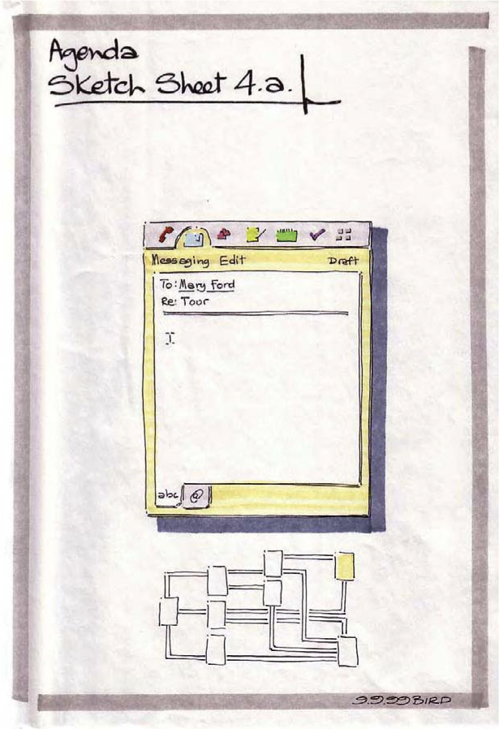
Sketches
… for interaction design have to deal with time
Buxton, B. (2007). Sketching user experiences: getting the design right and the right design. Morgan Kaufmann.
Notes:
User Experience is a very dynamic, complex and subjective phenomenon.
The sketches have to deal with time, phrasing, and feel—all attributes of the overall user experience.

Slide 21
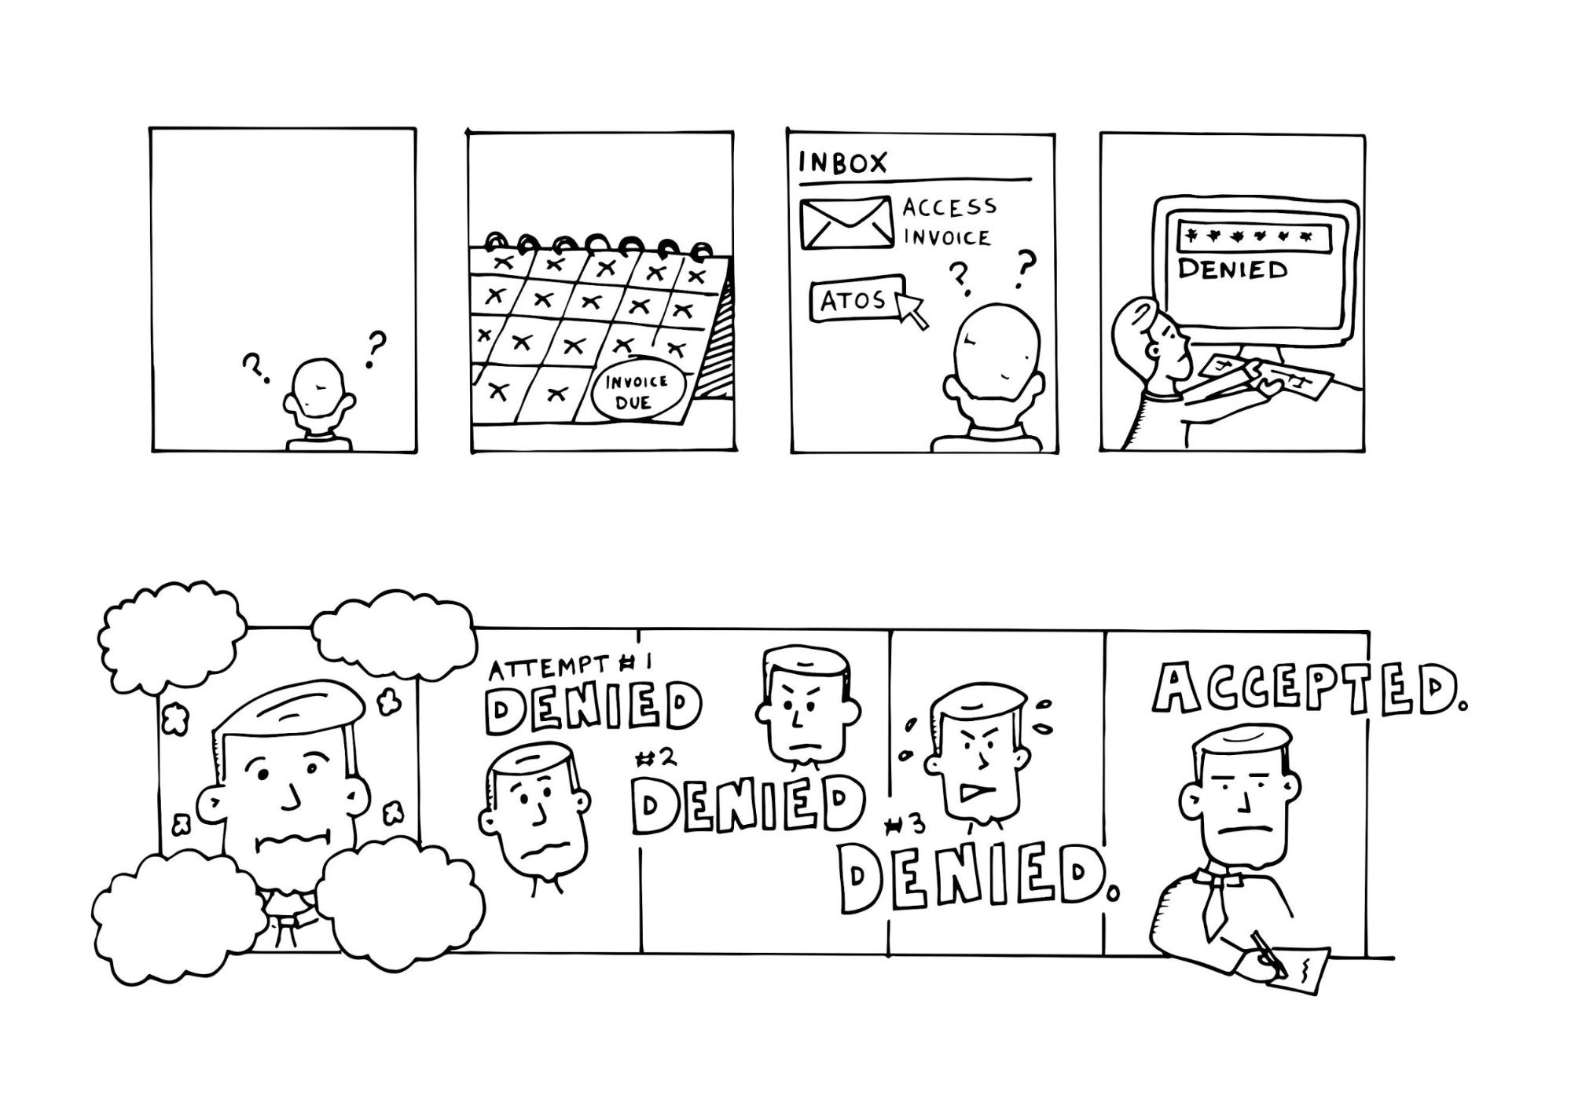
Sketches
… for interaction design have to deal with emotion / feeling
Spalton, C. (2017). 7 reasons for sketching in UX design. https://www.invisionapp.com/inside-design/ux-design-sketching/
Notes:
It is difficult to capture the emotions of what your users will be feeling at each stage. Here’s where comic strips and storyboards come in—they’re ideal for capturing both what the user is doing and feeling at each interaction or touchpoint.
Take some time to learn simple expressions representing happiness, confusion, anger, frustration, and relief

Slide 22
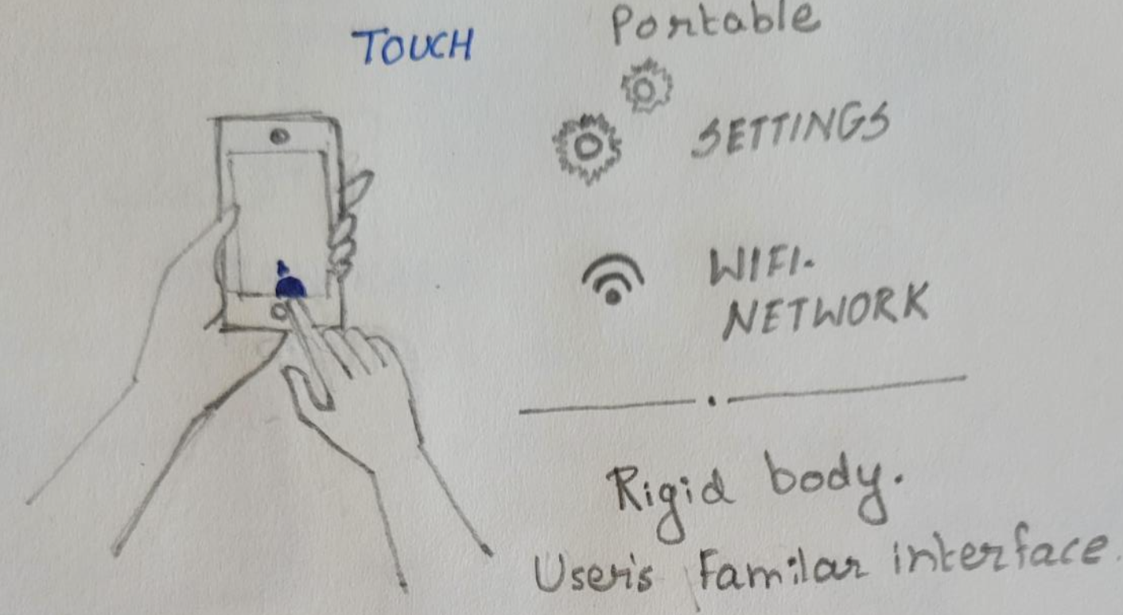
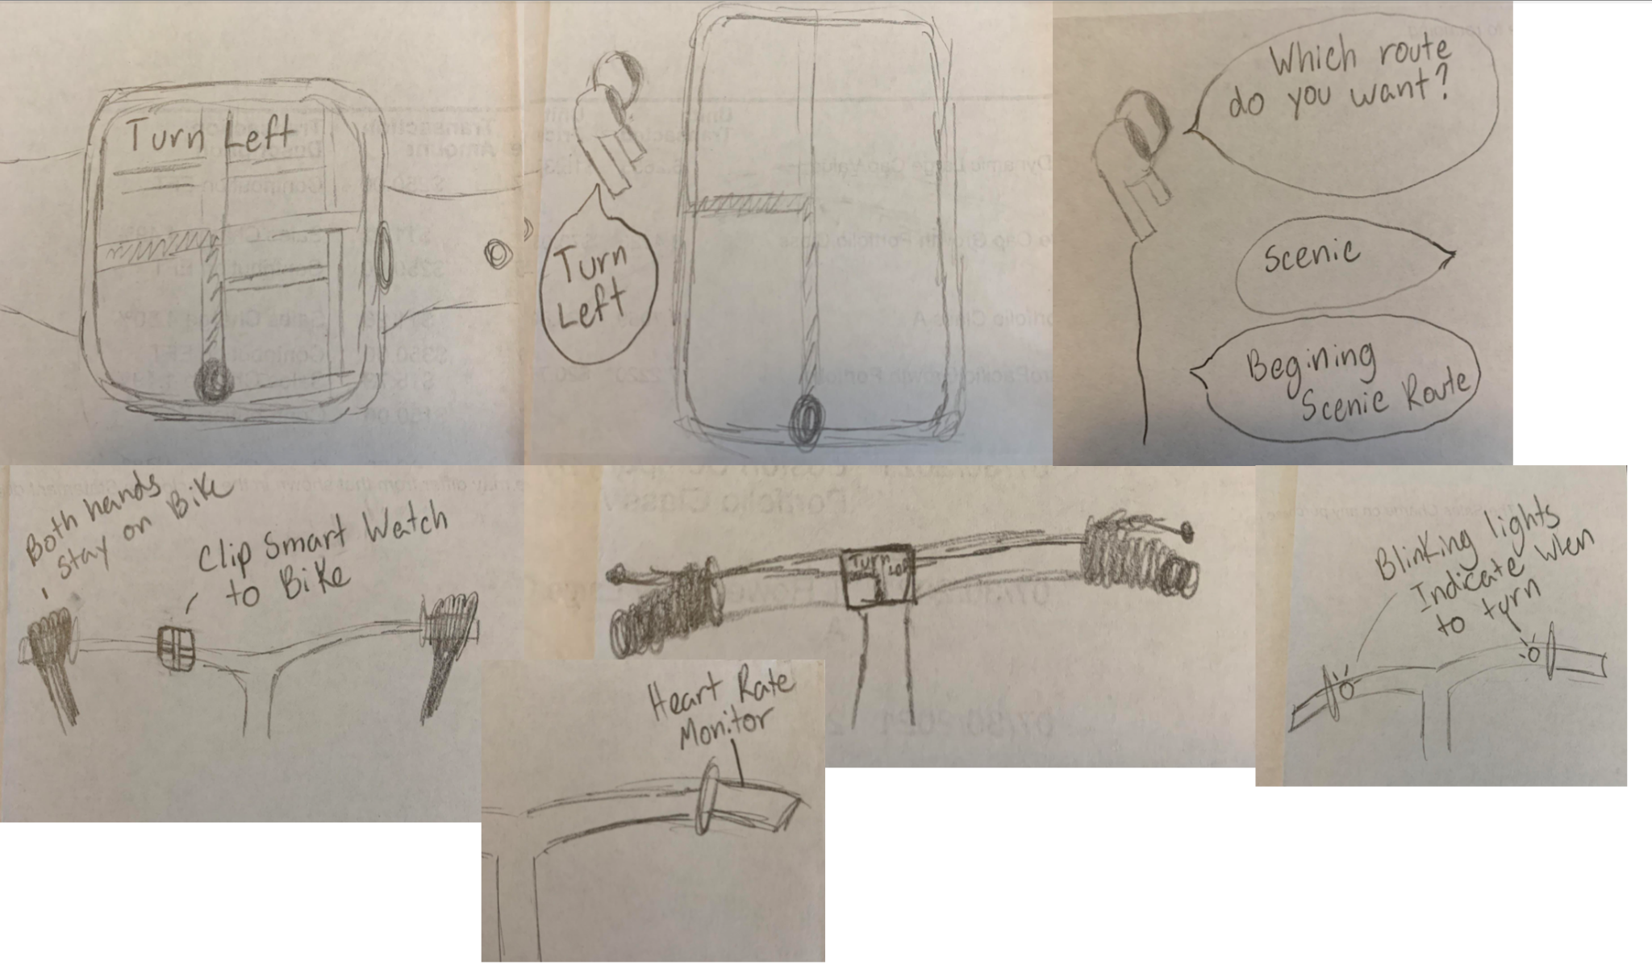
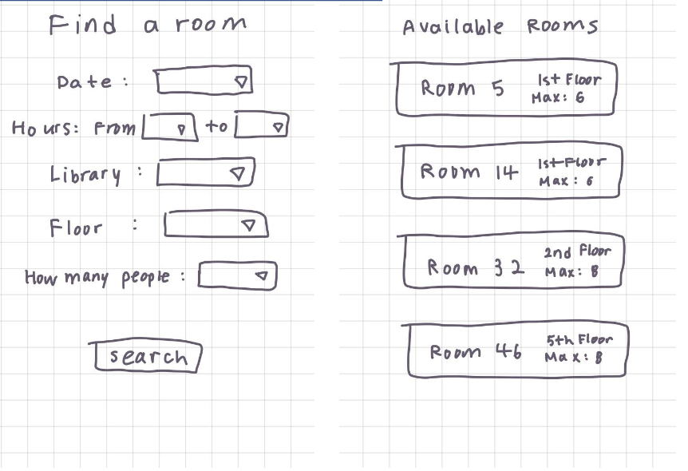
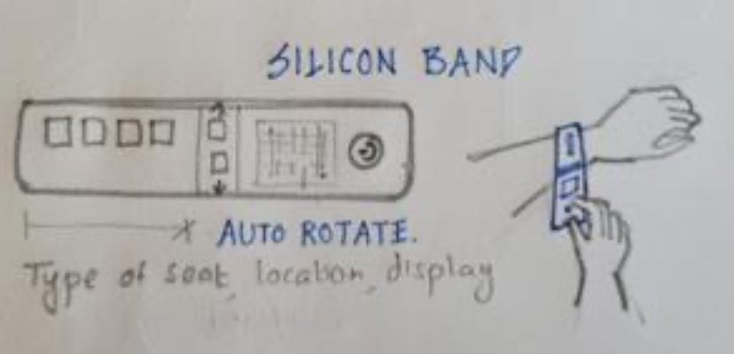
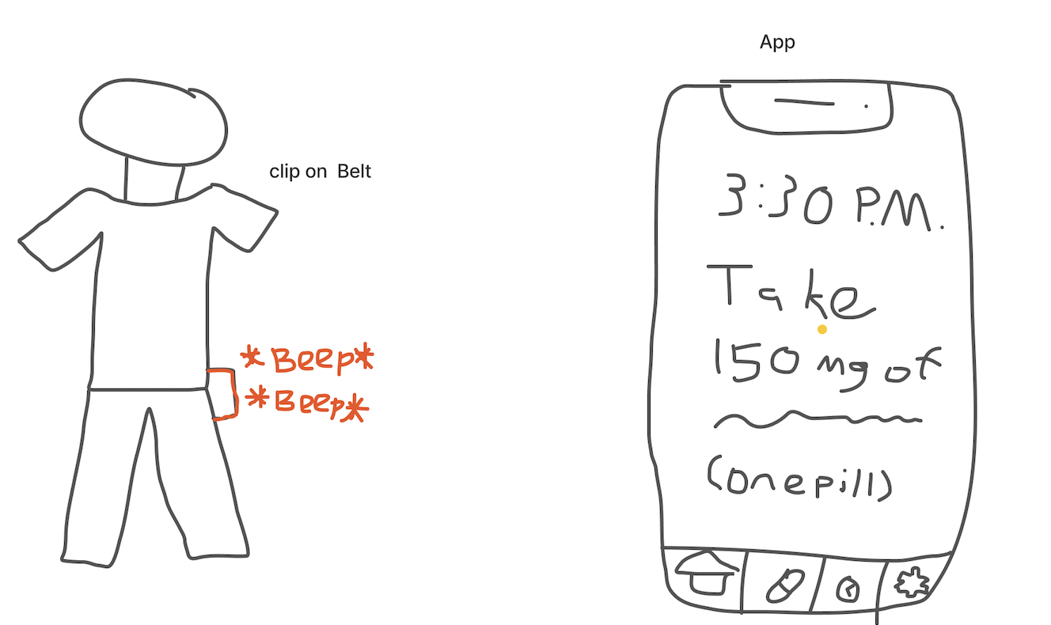
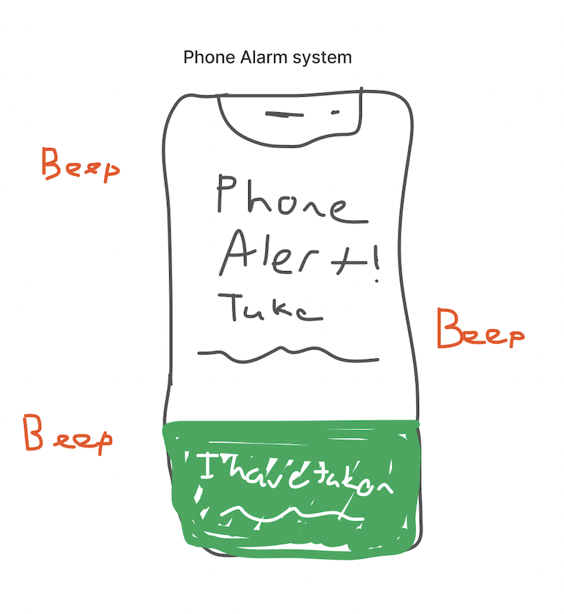
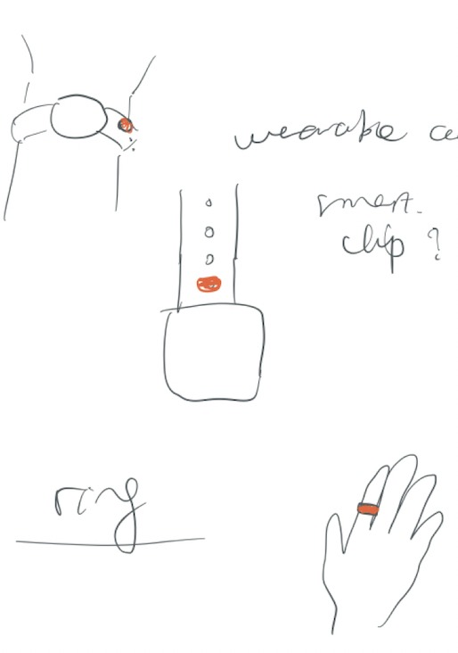
Sketches …
… can be sloppy! It’s all about communicating your ideas
Notes:
You don’t have to take the time to make beautifully sketches, nor should you!
Early sketches really help you understand your design space.
Use sketching as a brainstorming tool and try to simply get your ideas on paper quickly.
Practical tips: be sloppy, use a pen instead of a pencil, avoid lined paper

Slide 23
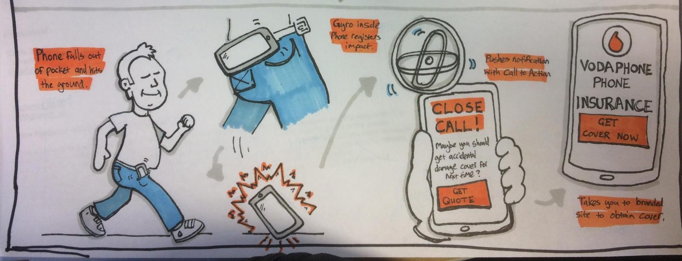
Sketches
… for interaction design have to deal with human element / use case
Spalton, C. (2017). 7 reasons for sketching in UX design. https://www.invisionapp.com/inside-design/ux-design-sketching/
Notes:
What the previous miss, is the human element,: what your users will be doing/ experiencing at each stage.
Learn to draw 5-10 common things to a standard you're happy with. (users, stick figures, phone, a room, furniture, car, atm machine)
Everyone relates lightbulbs to ideas, so if you’re in a lot of brainstorming meetings practice those.
It’s also likely that you’ll be working with people, so practice drawing stickpeople and adding more detail—computers, phones, and offices are all things that are likely to come up.
By nailing down a few frequently used subjects you’ll soon build up your own visual vocabulary of items that you can quickly and confidently draw upon.

Slide 24
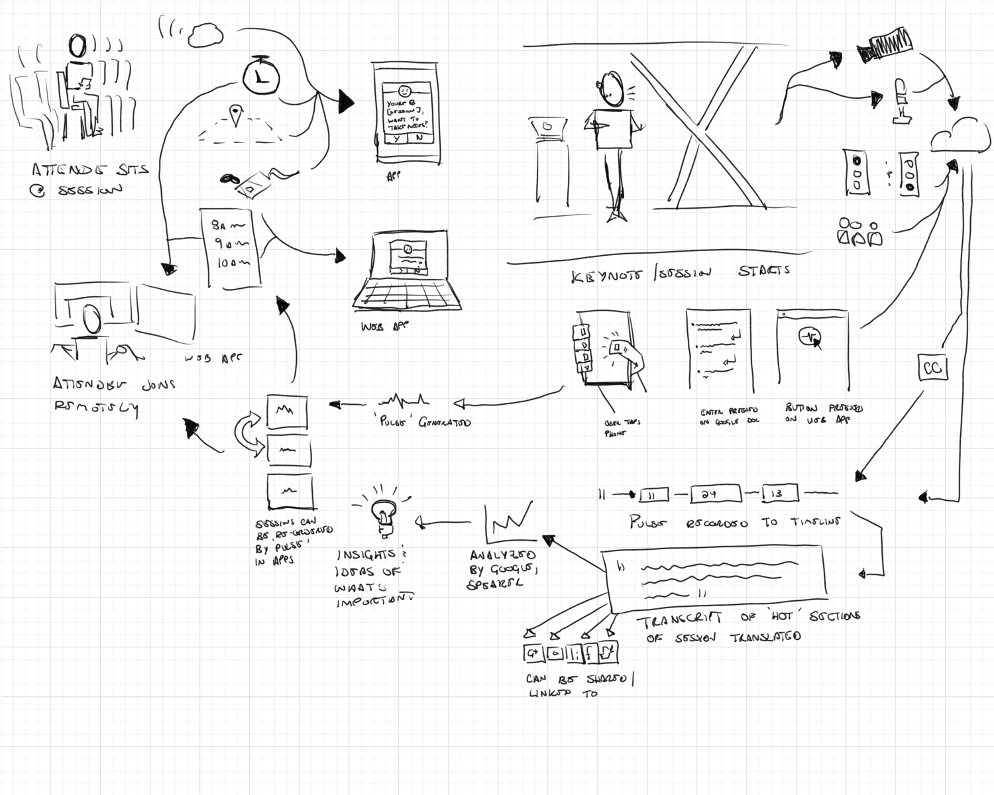
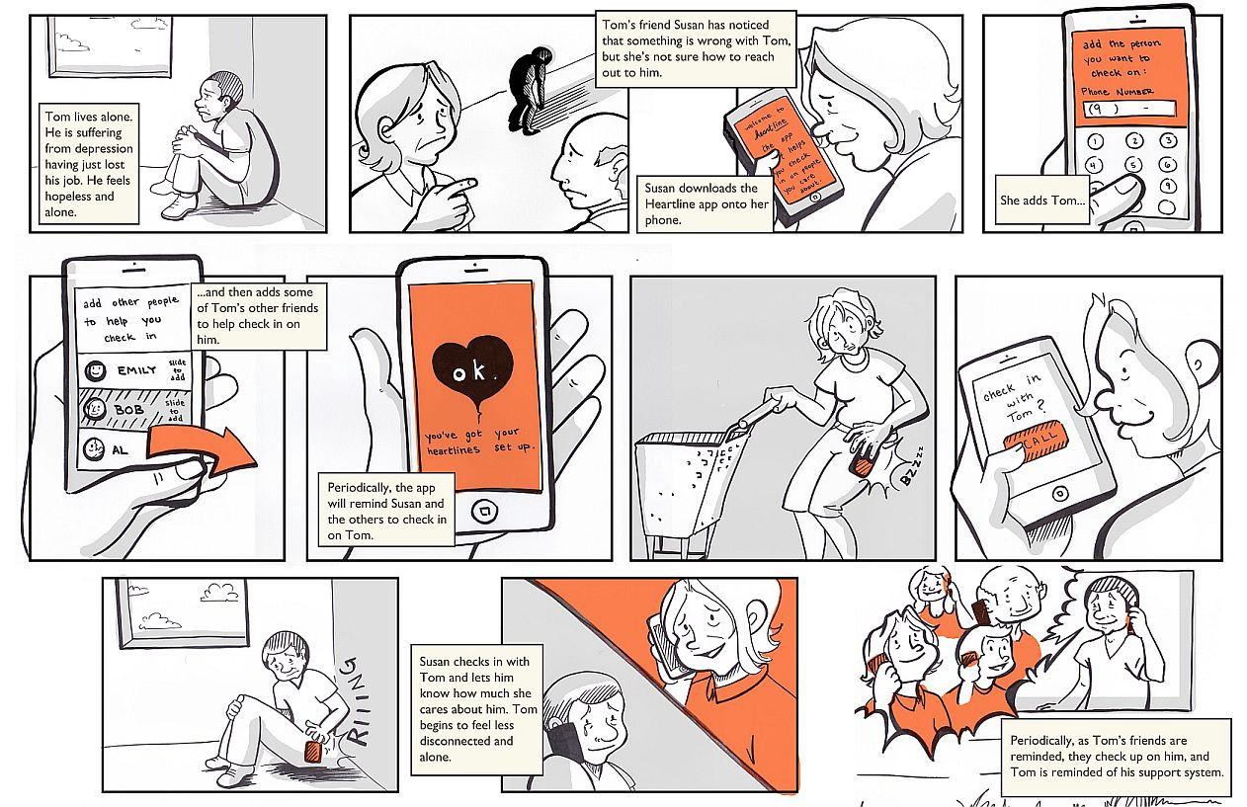
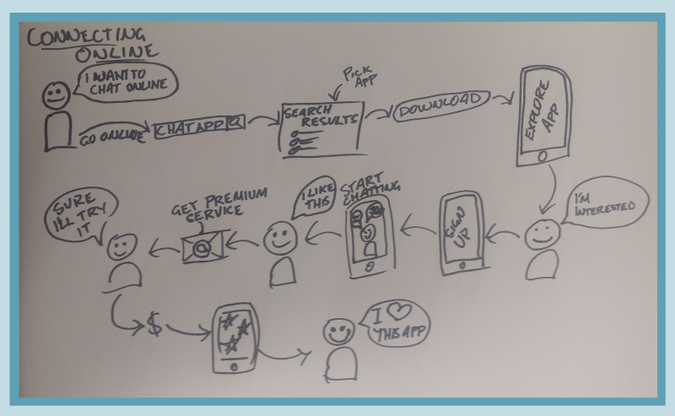
Sketches
… for interaction design have to deal with human element / use case
Spalton, C. (2017). 7 reasons for sketching in UX design. https://www.invisionapp.com/inside-design/ux-design-sketching/
Notes:
What the previous miss, is the human element,: what your users will be doing/ experiencing at each stage.
Learn to draw 5-10 common things to a standard you're happy with. (users, stick figures, phone, a room, furniture, car, atm machine)
Everyone relates lightbulbs to ideas, so if you’re in a lot of brainstorming meetings practice those.
It’s also likely that you’ll be working with people, so practice drawing stickpeople and adding more detail—computers, phones, and offices are all things that are likely to come up.
By nailing down a few frequently used subjects you’ll soon build up your own visual vocabulary of items that you can quickly and confidently draw upon.

Slide 25
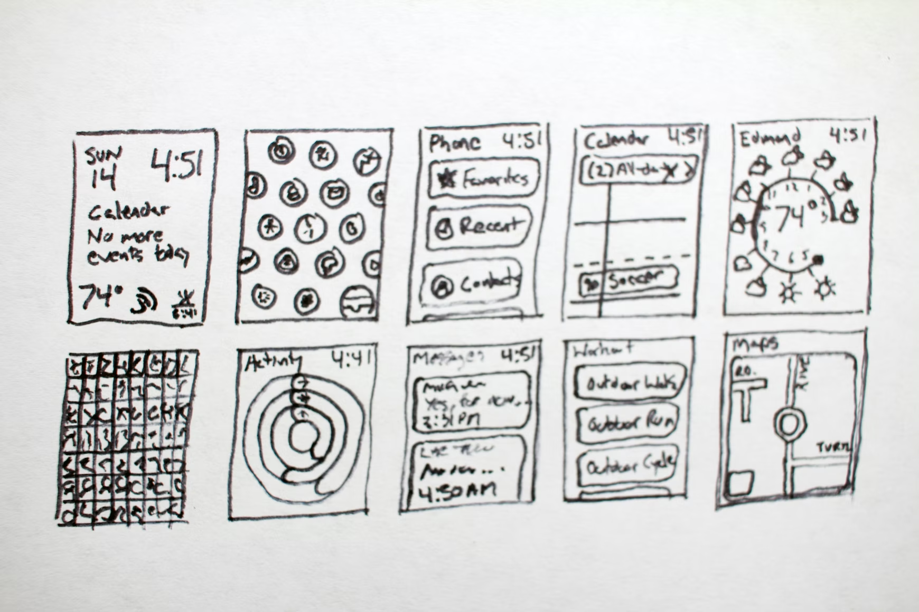
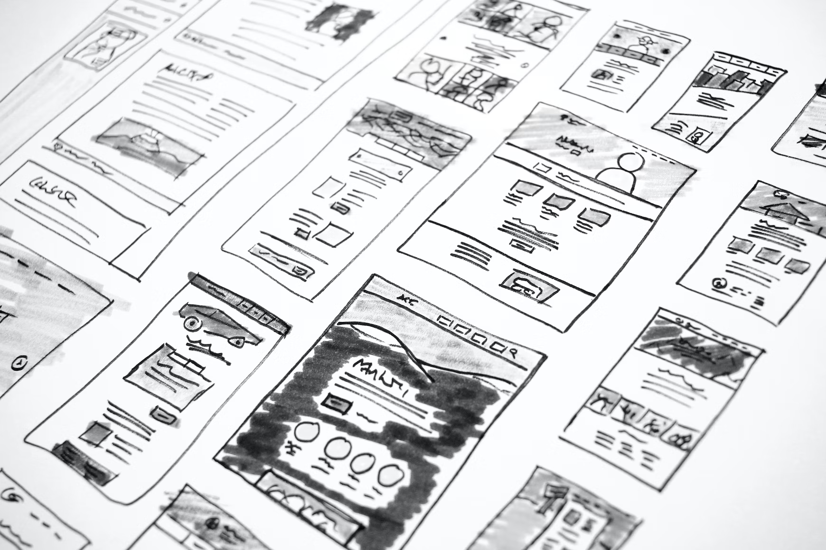
Sketches | In Summary
You don’t have to take the time to make beautiful sketches, nor should you!
Early sketches really help you to understand your design space.
Use sketching as a brainstorming tool and try to simply get your ideas on paper quickly.
Practical tips: be sloppy, use a pen instead of a pencil, avoid lined paper
Notes:
https://unsplash.com/photos/kdXlQSnYeWI
https://unsplash.com/photos/YM2MCZM43cM

Slide 26
Class Activity

Slide 27
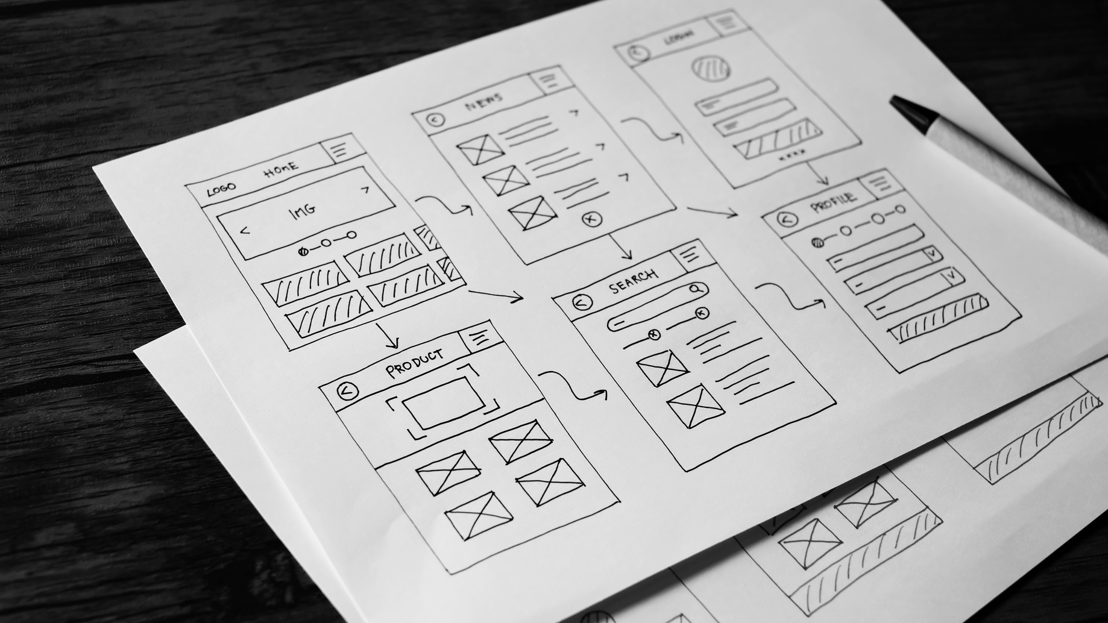
Class Activity:
App Sketches: Go to either, your favorite app or your most often used app. Sketch 3 different interface screens/views/states of that app.
Include labels, arrows and explanatory text to describe your sketches and show a flow.
Pair up with a fellow student. Share and introduce your 3 sketches of your chosen app to your classmate. Provide useful feedback to each other on how to improve the sketches. Take notes of the feedback you receive.
Based on the feedback you have received, create an improved and iterated set of new sketches, a version 2.0 showing clear improvements in comparison to your original sketches.
Outline the changes you added to your new sketches.

